Slide 1

Medical compass
Medical compass
البوصلة الطبية
Content Strategy

Slide 2
Table of Content
Introduction
Objectives SMART
SWOT analysis
Marketing Mix
Segmentation
Value Proposition
Competitive Analysis

Slide 3
Medical compass
Introduction
البوصلة الطبية
Content Strategy

Slide 4


by
mohamed attia
CONTENT OBJECTIVES
01
02
03
Health Awareness
Preventive Health Education
Encouraging Social Engagement
04
05
06
Supporting Mental Health
Raising Awareness about National Campaigns
Combating Misinformation & Correcting Health Myths

Slide 5
Medical compass
Objectives SMART
البوصلة الطبية
Content Strategy

Slide 6
Objective
Objective is to create social media content to achieve 100 successful contracts through engage 100K high patient in 3 months

Slide 7
Objectives SMART
• Increase awareness among the target audience (ages 18-50) about six key health topics: Obesity, Diabetes, Pediatrics, Eye Diseases, Sports Medicine, and Oxygen Therapy through simplified and reliable medical content.
•Reach at least 30,000 people on digital platforms within 6 months, with an
engagement rate of no less than 15% on posts.
•Produce 3 awareness posts per week, 2 short videos per month, and simplified articles in collaboration with 2-3 medical specialists to ensure credibility.
• Contribute to public health by providing medical knowledge that supports prevention, early detection, and better lifestyle choices, aligning with broader community health goals.
• Within 6 months, deliver 72 awareness posts, 12 short.

Slide 8
Medical compass
SWOT analysis
البوصلة الطبية
Content Strategy

Slide 9


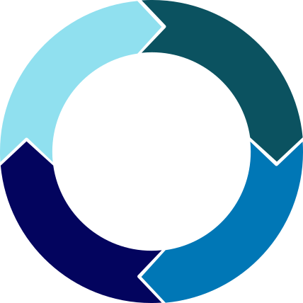


S
W
STRENGTHS
WEAKNESSES
ANALYSIS
T
O
THREATS
OPPORTUNITIES

Slide 10

STRENGTHS
Arabic-focused medical content filling a major market gap.
varity of content formats like posts , images , videos
up-to-date information

Slide 11

WEAKNESSES
new brand
most of the admin are not in the medical fields
Potential misunderstanding of medical content.
Difficulty in buildin g trust and engagment.

Slide 12

OPPORTUNITIES
Scarcity of reliable Arabic health platforms.
Mobile app expansion for better accessibility.
Collaborations with hospitals or public health bodies.
Positioning as a regional health authority.

Slide 13

THREATS
Competition from major platforms (e.g., Altibbi, WebMD).
Censorship or regulatory restrictions.
Spread of misinformation without proper moderation.
Reputation threats via fake reviews or cyberattacks.

Slide 14
Medical compass
Marketing Mix
البوصلة الطبية
Content Strategy

Slide 15
Marketing Mix
Your Mental Health Comes First... Wellness Starts Within
Product – The Service Offered
Place – Channels and Distribution
Promotion – Marketing Communication
Price – Pricing Strategy
mental and medical content (videos, articles, infographics, podcasts)
One-on-one consultation sessions at affordable rates
Google Ads for educational content
Mobile app (Android & iOS)
Short courses on stress management, depression, anxiety
Monthly subscription plans for exclusive courses
Collaborations with universities, schools, clubs
Sponsored social media campaigns
Online consultations with certified psychologists
Discounts for students and low-income individuals
Active social media presence: Facebook, Instagram, TikTok, YouTube
Interactive challenges (e.g., “30 Days to Improve Your Mood”)
Awareness campaigns aligned with global health
Corporate partnerships to provide access to employee wellness packages
Ongoing awareness campaigns
Interactive website

Slide 16


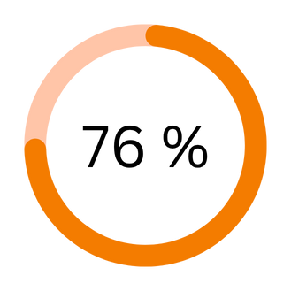
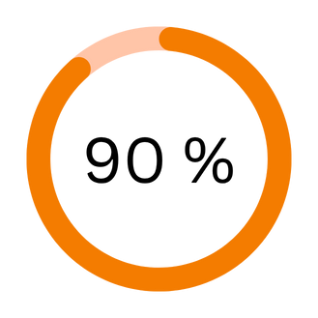
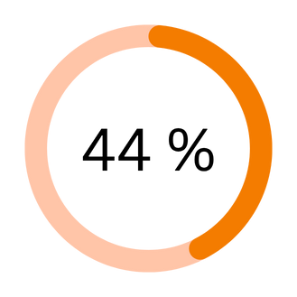
Key Performance Indicators
We will track low engagement with mental health content, high drop-off rates on self-help pages, reduced sign-ups for consultations, and negative feedback. These indicators help us identify gaps in trust, relevance, or accessibility—allowing prompt adjustments to protect user impact, credibility, and community engagement.
KPI 02
KPI 03
KPI 01
Engagement rate on content
Conversion rate of visitors to subscribers
Number of new users per month

Slide 17
Marketing Mix
The marketing mix strategy for the mental health awareness campaign is based on the 4Ps framework—Product, Price, Place, and Promotion—designed to effectively deliver public health education. The Product includes a digital platform offering free, high-quality Arabic mental health content such as videos, blogs, self-assessment tools, and expert-led webinars. The Price model focuses on inclusivity, providing most services for free with optional low-cost add-ons like private consultations or exclusive content. For Place, the campaign ensures wide accessibility through mobile-friendly platforms, social media channels, and messaging apps to reach users where they are most active. Promotion centers on engaging and educational content marketing, partnerships with local influencers, live Q&A sessions, mental health challenges, and community-driven campaigns. This marketing mix supports the project’s mission of improving mental health literacy in Arabic-speaking communities by making support accessible, trustworthy, and culturally relevant.

Slide 18
Medical compass
Segmentation
البوصلة الطبية
Content Strategy

Slide 19


The market segmentation that we will target is:
MARKET SEGMENTATION
Segmentation Objective
Since the content is focused on general medical awareness, it’s essential to segment the audience based on:
Who needs the information
How they use the internet
The goal is to ensure the content doesn’t just go viral, but actually educates and raises awareness.

Slide 20
Demographic Segmentation
Age Group:
Focus on ages 18 to 60 with customized content for:
Younger audiences (e.g., child nutrition)
Older audiences (e.g., elderly care)
Gender:
Content targets all genders, with specific topics tailored for:
Women: maternal health, reproductive wellness
Men: chronic conditions like hypertension
Education Level:
Focus on an educated audience or those interested in self-learning
Students, graduates, professionals
Occupations:
Students,Employees,Freelancers,Mothers ,People working from home
All of them need reliable and simplified medical information.
.

Slide 21
Geographic Segmentation
Location:
The content is mainly targeted at people in Egypt, using simple, clear Arabic that is easy to understand across different dialects.
Usage Patterns:
Most users access content via mobile devices, especially from major cities like Cairo and Alexandria. So, all content should be mobile-friendly in format and design.

Slide 22
Classification the segment
Class A – Age 18–33
Market Segmentation | Distribution Channel | Product Preference
Young adults (students, early professionals) | Mobile-friendly platforms: Instagram, TikTok, Facebook | Mental health, quick health tips, short videos
Class B – Age 34– 60
Market Segmentation | Distribution Channel | Product Preference
Adults with families or stable careers | Facebook, YouTube, health blogs, WhatsApp groups | Family health, parenting, chronic illness awareness

Slide 23
.Behavioral Segmentation
Why they search:
To check symptoms, understand illnesses, or get reassurance about medications.
How they engage:
Prefer short, clear posts, videos, and infographics.
Share content that includes strong advice or health warnings.
What they want:
Disease prevention, self-awareness, managing daily symptoms, and peace of mind.
.Psychographic Segmentation
Key Interests:
Disease prevention, nutrition, mental health, chronic conditions, first aid, family health, safe medication use, and daily health tips.
Lifestyle:
Health-conscious, curious, and proactive individuals who want to learn, stay informed, and make smart health decisions for themselves and their families.

Slide 24
Medical compass
Value Proposition
البوصلة الطبية
Content Strategy

Slide 25









Value Proposition
ااابباا
Gain creators
Gains
A health platform that provides educational information in an easy and fun way.
Dismissing health rumors in an engaging way.
Easy access to verified, simple, and trusted medical content
Constantly promoting mental health without prejudice.
Searching for reliable and accurate health information.
Choosing the right medical specialty
Products & services
Practical preventative advice to effectively immunize individuals.
Daily health posts
Interactive services that respond to inquiries quickly.
Better understanding of the health of the body and mind.
Understanding which medical specialty suits their health needs.
Content about mental health
Continuous alerts keep you on track with national campaign dates!
Improved daily health habits
Direct response to inquiries
Customer
jobs
Correcting widespread medical myths and misinformation.
National campaign dates alerts
Widespread misinformation and unverified health content online.
Special content for medical specialties and fields
Correcting wrong information always
Making better daily health decisions.
Difficulty understanding complex medical terms.
A useful and simple guide to medical specialties
Accessing simplified medical content in plain language.
Weekly preventive awareness content that includes periodic psychological support
Poor preventive health awareness
Regular content for national campaigns
Low trust in medical content shared on social media.
Pain relievers
Pains
Value proposition
Customer segments

Slide 26
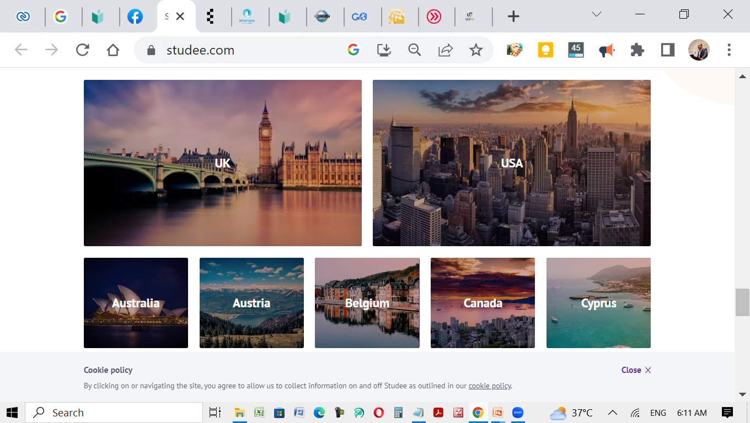

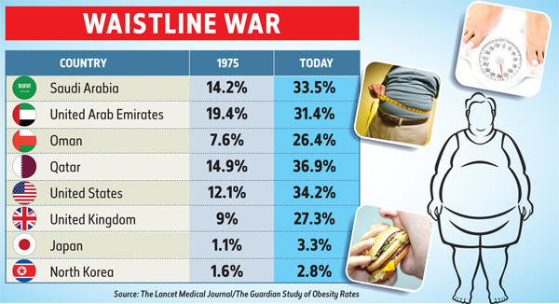

Countries

Slide 27
Value Proposition
Our medical platform provides reliable, simplified, and interactive health content that helps users understand their medical specialties, correct misconceptions, and prevent diseases, while enhancing confidence in medical information and empowering them to make better health decisions in their daily lives.

Slide 28
Medical compass
Competitive Analysis
البوصلة الطبية
Content Strategy

Slide 29
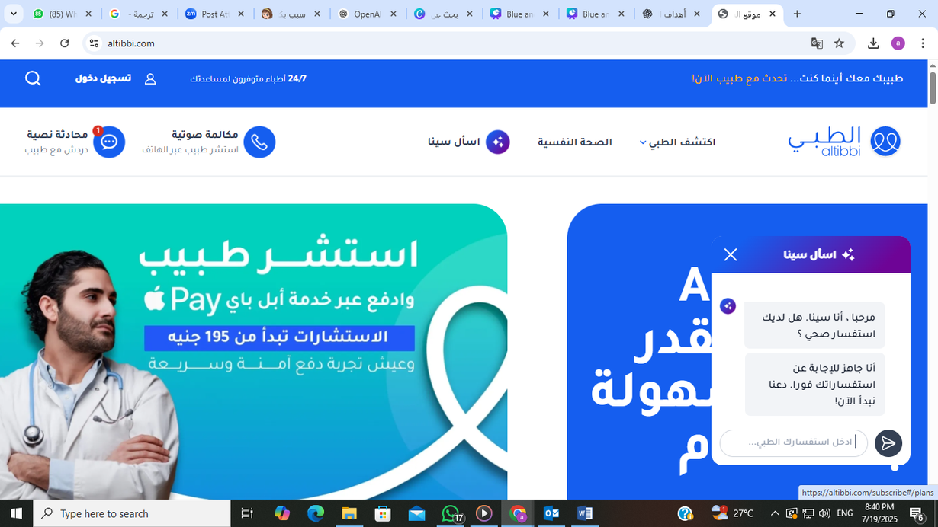

altibbi
website &app& facebookpage
A full-service medical platform offering a mobile app and Facebook page, allowing users to book appointments across all medical specialties.

Slide 30

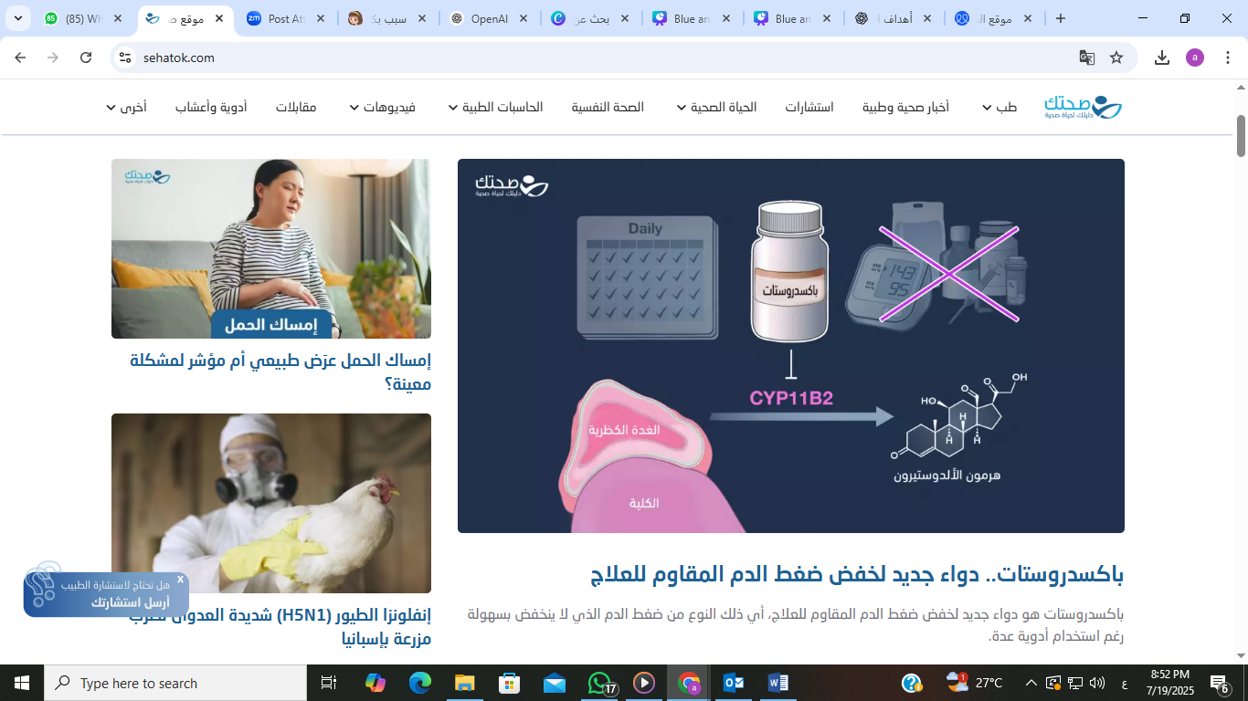





GROUP
PROJECT
sehatok
A comprehensive medical platform available through a website

Slide 31
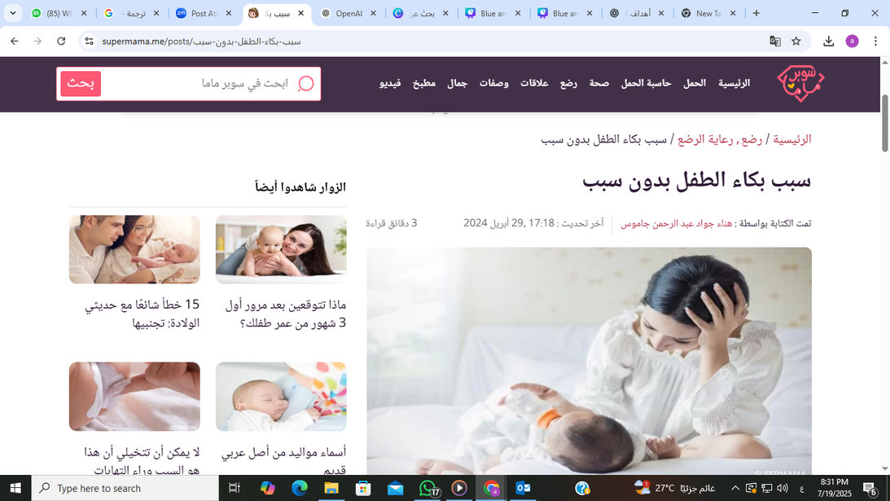
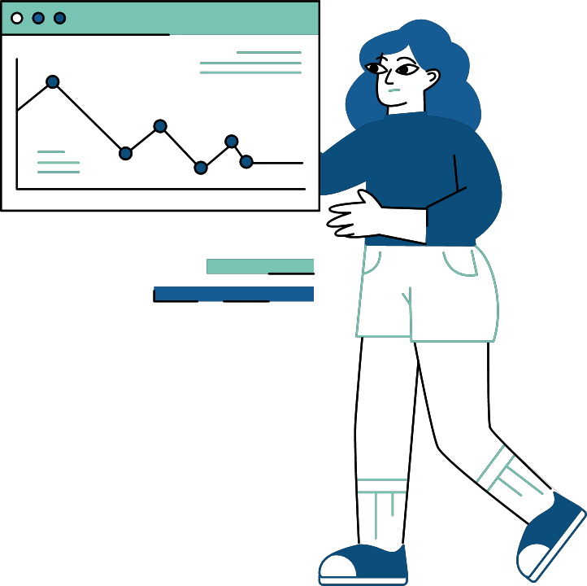
super mama
website & facebook page
A specialized website for mothers and children

Slide 32
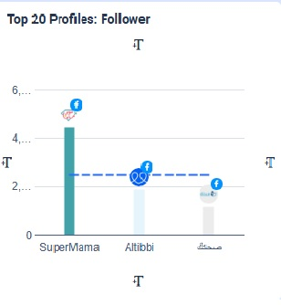
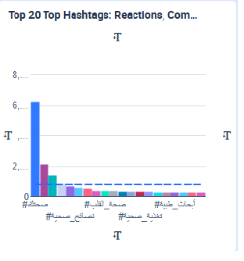
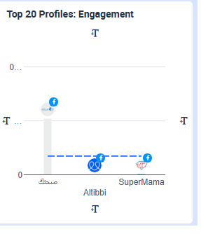

Slide 33
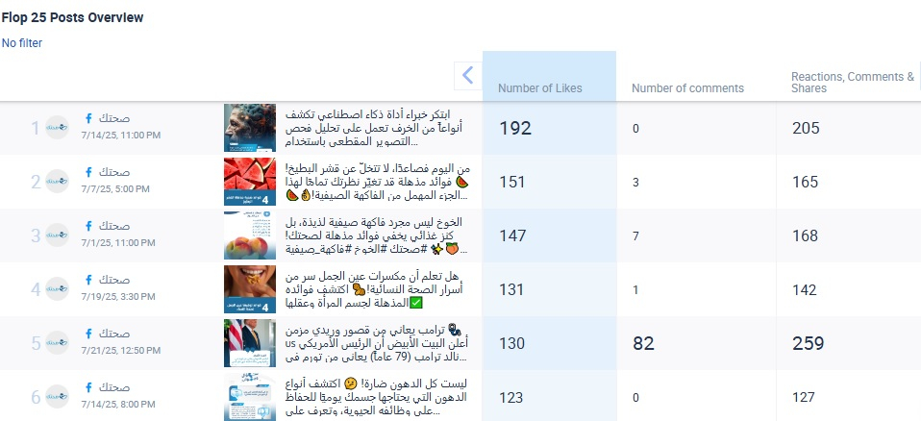
Top post competitors

Slide 34





GOT QUESTIONS?
Reach out.
Calle Cualquiera 123, Cualquier Lugar

